Slide 1
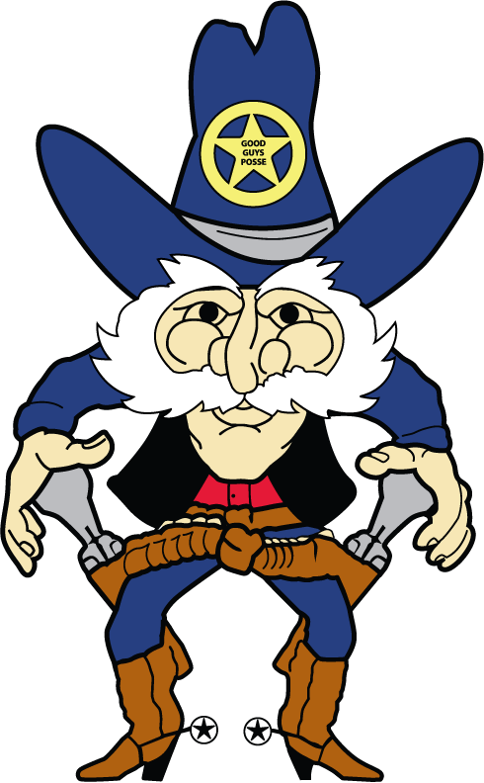
Good Guys Posse Gunfight at Dry Gulch Ranch Stage 1
“Sound Off “
“Gimme your left, your right ,
your left,right, left, right”!
10 – Rifle
10- Pistol
4+ - Shotgun
R4
R2
P10
R5
R1
R3
P9
P1
P3
S1
S2
S3
S4
P5
P2
P4
Left TABLE
Right TABLE
PROCEDURE
All Shotgun Targets are engaged until down
Pistols loaded five rounds each and holstered. Rifle, ten rounds, hammer down on MT chamber and shotgun open and MT. Rifle and shotgun staged on right table. Starting position at left table. At attention say the line “SIR , YES SIR”.
ATB engage pistol targets as follows P1 P2 P2 P3 P3 P3 P2 P2 P1 P1. Holster pistols. Move to right table. Engage rifle targets as follows R3 R2 R2 R1 R1 R1 R2 R2 R3 R3. Restage rifle open and MT on table. Retrieve shotgun and engage targets as follows S1 S2 S3 S4. Proceed to the unloading table.
Stages by Old B C Coot
MAY 2018

Slide 2
Good Guys Posse Gunfight at Dry Gulch Ranch Stage 2
R2
As Gomer says,
“Surprise! Surprise! Surprise”
Aces beats Kings
10 – Rifle
10- Pistol
4+ - Shotgun
P1
P2
P3
R1
R2
R3
R4
R5
10 – Rifle
10- Pistol
2+ - Shotgun
S1
S2
R1
R2
R3
R4
R5
P1
P2
P3
P4
P5
S1
S2
S3
S4
TABLE
R2
P2
TABLE
PROCEDURE
All Shotgun Targets are engaged until down
PROCEDURE
All Shotgun Targets are engaged until down
You knew what it was going to be each time last year.
This year it will be a surprise each month!
P1
P2
P3
P4
P5
Stages by Shamrock
SASS Charity2013
Stages by Old B C Coot
May 2018

Slide 3
Good Guys Posse Gunfight at Dry Gulch Ranch Stage 3
“Inside out?”
10 – Rifle
10 - Pistol
4+ - Shotgun
R1
R2
R3
R4
Shotgun target #3 need not go down
P1
P2
P3
P4
S1
S2
S3
S4
P1
P2
P3
P4
P5
R5
TABLE
TABLE
PROCEDURE
All Shotgun Targets are engaged until down
Pistols loaded five rounds each holstered. Rifle, ten rounds, hammer down on MT chamber and shotgun open and MT. Rifle and shotgun staged at right table. Starting position at left table. With hands flat on the table say the line “I think Coot’s lost his mind”
ATB engage pistol targets as follows P2 P3 P3 P1 P1 P1 P4 P4 P4 P4. Holster pistols. Move to right table retrieve rifle engage targets as follows R2 R3 R3 R1 R1 R1 R4 R4 R4 R4. Restage rifle open and MT on the table. Retrieve shotgun and engage targets as follows S2 S3 S1 S4. Proceed to the unloading table.
Stages by Old B C Coot
May 2018

Slide 4
Good Guys Posse Gunfight at Dry Gulch Ranch Stage 4
“Outside in?”
10 – Rifle
10- Pistol
4+ - Shotgun
R1
R2
R3
R4
R5
P5
P4
P1
P2
P3
P4
S1
S2
S3
S4
P3
LEFT WINDOW
Right WINDOW
DOORWAY
PROCEDURE
All Shotgun Targets are engaged until down.
Pistols loaded five rounds each holstered. Rifle, ten rounds, hammer down on MT chamber and shotgun open and MT. Rifle staged in the right window and shotgun staged on table at the doorway. Starting position standing at the left window. With hands on either side of the window say the line “Yep Coot has lost his mind!”
ATB: Engage pistols target as follows P1 P4 P4 P2 P2 P2 P3 P3 P3 P3. Holster pistols and move to right window. Engage rifle targets as follows R1 R4 R4 R2 R2 R2 R3 R3 R3 R3. Restage rifle open and MT on table. Pick up shotgun and engage targets as follows S1 S4 S2 S3. Proceed to the unloading table.
Stages by Old B C Coot
May 2018

Slide 5
Good Guys Posse Gunfight at Dry Gulch Ranch Stage 5
11 – Rifle
11- Pistol
4+ - Shotgun
T1
T2
T3
T4
T5
R4
R
R6
R3
R5
R1
R2
R3
R4
R5
R4
R6
R1
P6
S1
S2
S3
S4
P1
P2
P3
P4
P5
S1
S2
P1
P2
P3
P4
TABLE 2
S3
TABLE 1
WINDOW
DOORWAY
PROCEDURE
All Shotgun Targets are engaged until down
TABLE
Pistols loaded five rounds each holstered. Rifle, ten rounds, hammer down on MT chamber staged on Table 2 and shotgun open and MT stage d on Table 1. Starting position at window with arms folded. Say the line “I knew I should have bought that Walch Navy!”
ATB Engage pistol targets P1 to P5 in a DOUBLE TAP SWEEP LEFT TO RIGHT RELOAD ONE BULLET AND ENGAGE P6. Holster pistols. Retrieve shotgun and move to table 2 restage shotgun on table 2 pick up rifle and engage targets R1 to R5 in a DOUBLE TAP SWEEP LEFT TO RIGHT RELOAD ONE BULLET AND ENGAGE R6. Restage rifle on table 2 open and MT. Retrieve shotgun and engage targets in a left to right sweep. Proceed to unloading table.
R2
R1
R1
Stages by Old B C Coot
May 2018

